Slide 1
Neural Machine Translation using Deep Learning
Richa Ranjan, MSc Data Science
Supervisor: Professor Mahesan Niranjan

Slide 2
AIM
AIM: To build a Machine Translation system using Deep Neural Networks
Languages involved: Hindi and English
This project aimed at achieving higher translation accuracies than state-of-the-art machines.
Scope: To demonstrate the empirical process of training a Deep Neural Network to obtain maximum efficiency in the said task

Slide 3
Deep Learning: Why the “Buzz”?
Deep Learning has achieved near-human accuracies in a range of applications.
A major breakthrough was in 2006, when Geoff Hinton proposed the idea of Deep Belief Networks.
In 2012, the ImageNet challenge was held, where machines were trained to identify around 1000 categories of objects.
AlexNet by Alex Krizhevsky, Ilya Sutskever, and Georey Hinton brought about the revolution with even deeper networks.
Further, broadening with GoogleNet and massive deepening of networks with ResNet came into picture with networks as deep as 152 layers!

Slide 4
Recurrent Neural Networks
Recurrent Neural Networks (RNNs) are instrumental in applications involving sequential data, e.g. Machine Translation, Speech Recognition etc..
Text sequences involve processing each word at a time step.
Sequential data requires information persistence, similar to a human processing the data.
Traditional Neural Networks cannot handle such dependencies.
RNNs provide mechanisms to pass activation values from the previous step to the next, with the use of feedback loops.

Slide 5
LSTM
Addresses the vanishing or exploding gradient problems in RNNs
Long Short-Term Memory (LSTMs) are used to learn long-term dependencies efficiently in a sequential data.
Example sentences:
The cat, which ate fruits, milk, cookies,……was full.
The cats, which ate fruits, milk, cookies,……were full.
LSTMs contain 4 layers in each repeating network.
To forget/change a memory, gates are used, which saturate at 0 and 1

Slide 6
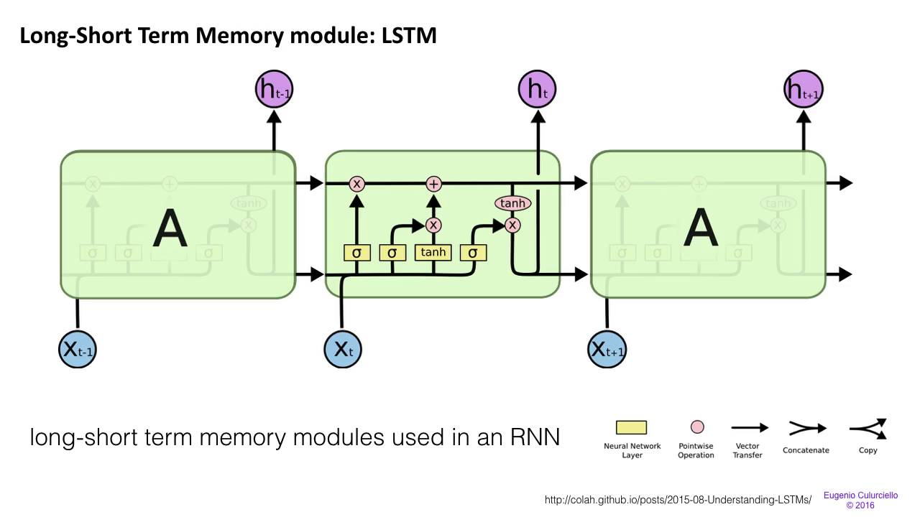
LSTM Architecture

Slide 7
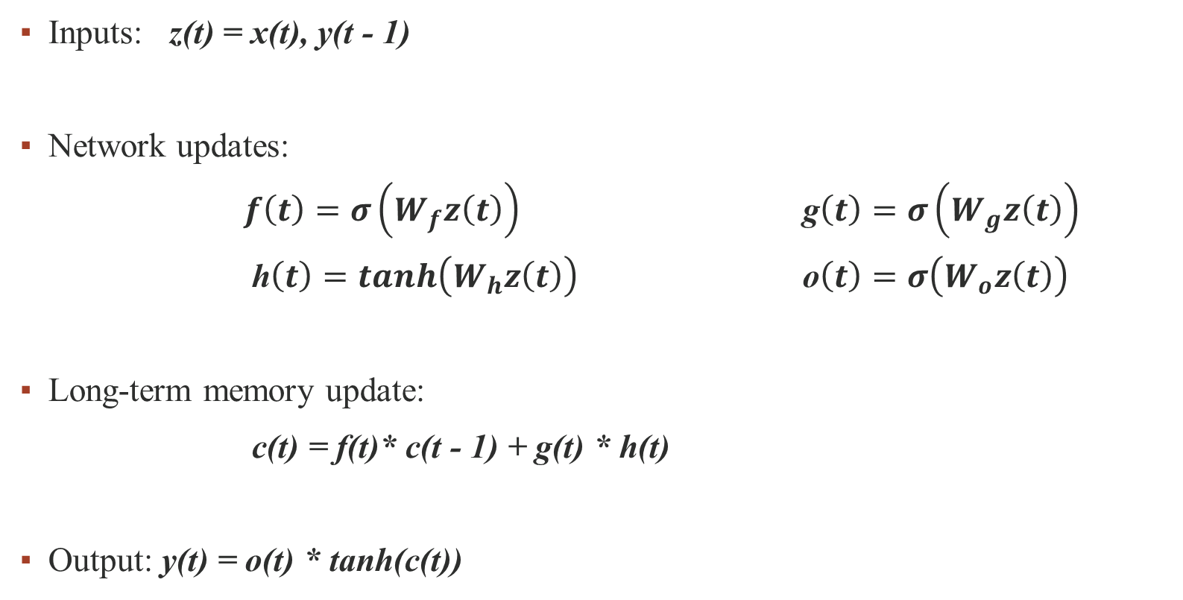
LSTM Equations
Inputs: z(t) = x(t), y(t - 1)
Network updates:
$f\left(t\right)=σ\left(W_{f}z\left(t\right)\right)$ g$\left(t\right)=σ\left(W_{g}z\left(t\right)\right)$
h$\left(t\right)=tanh\left(W_{h}z\left(t\right)\right)$ o$\left(t\right)=σ\left(W_{o}z\left(t\right)\right)$
Long-term memory update:
c(t) = f(t)* c(t - 1) + g(t) * h(t)
Output: y(t) = o(t) * tanh(c(t))

Slide 8
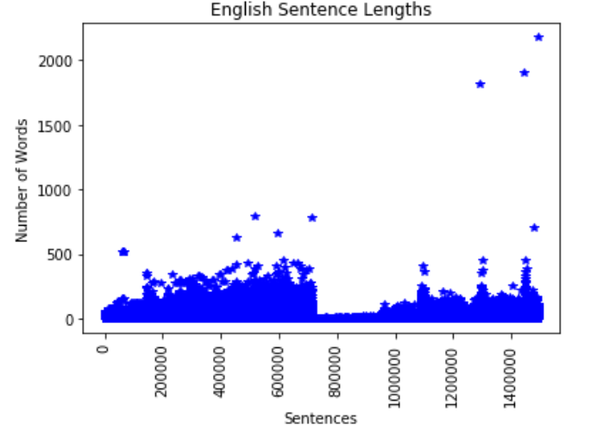
The Corpus
Hindi-English parallel corpora of 1,492,827 sentences, from IIT Bombay
About 1.85% of the words in Hindi document were in English
Max length of English sentences = 2178
Max length of Hindi sentences = 2068
Average length of English sentences ≈ 14
Average length of Hindi sentences ≈ 15
Challenges: Handling different language text in English document, handling outliers, script differences, bad text, inconsistencies

Slide 9
Model Design
Clean, tokenize and index the data
Encode: each input and output sequence are encoded to integers and padded to the maximum length for uniformity
Training: Weights for each word are learnt and updated throughout the training process
Predictions: Probability for each word’s occurrence in the sequence
Decode: Reverse mapping of the index with maximum probability, using Beam Search algorithm

Slide 10
Sequence to Sequence
Input sequence: fed into the encoder, state vectors obtained
(No. of pairs, Max Hindi sentence length)
state vectors from the encoder fed into the decoder, along with target sequence
(No. of pairs, Max Eng sentence length)
Sample the next character (here, using highest probability of softmax layer and Beam Search)
Decoder output: same as decoder input, offset by 1 timestep.
Append this new character to the target sequence
Repeat this until <EOS> or character max limit reached.

Slide 11
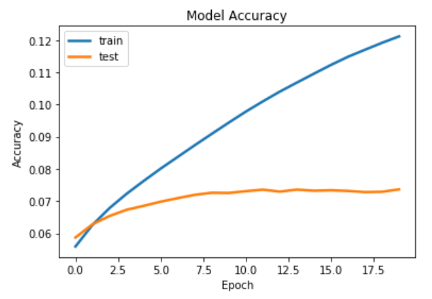
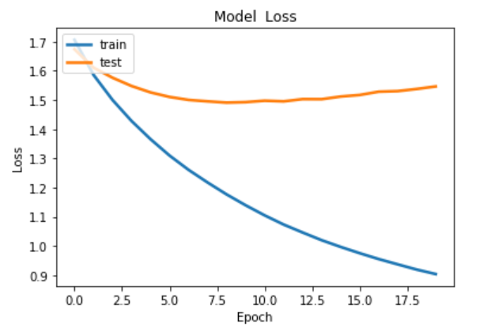
Training Parameters
Data is processed batch by batch while training, for parallel processing in case of massive data such as this.
Model trained for 10 epochs in about 44 hours!

Slide 12
Sequence to Sequence Model

Slide 13
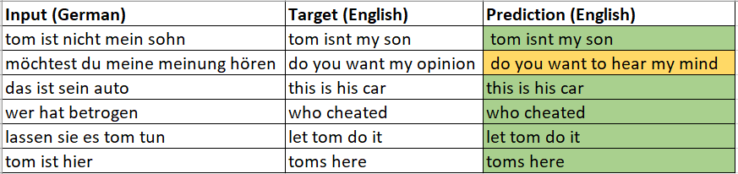
Test Model
Model was initially trained on German-English data to understand the training logistics of text data using Neural Networks
BLEU (Bilingual Evaluation Understudy): most commonly used automatic evaluation metric in MT community
For German-English data, the highest BLEU score achieved was 0.31

Slide 14
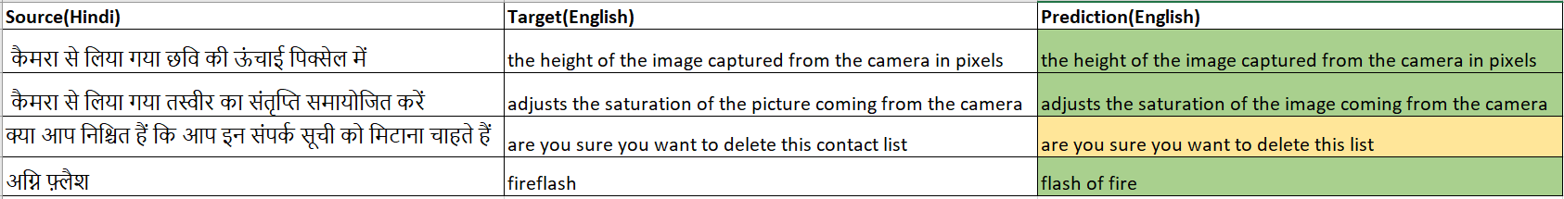
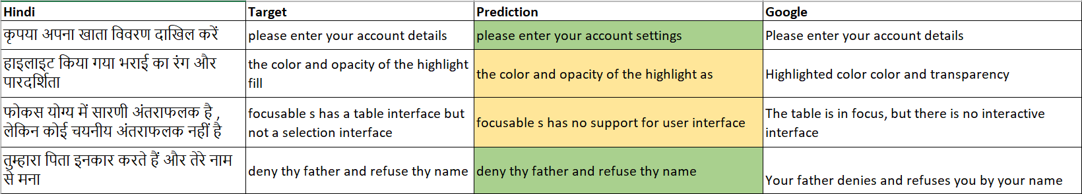
Hindi-English Results
Sample predictions from the model:
Some sample sentences were tested and compared with the output from Google Translate:
The best BLEU score achieved by the model: 0.33 (training set) and 0.30(test set)

Slide 15
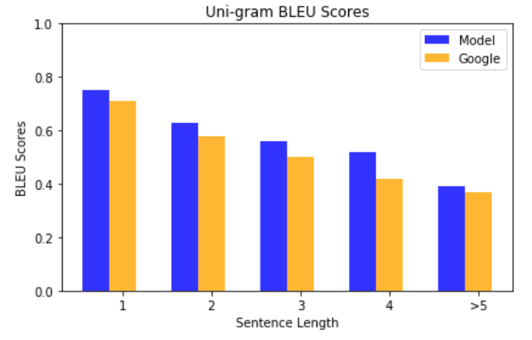
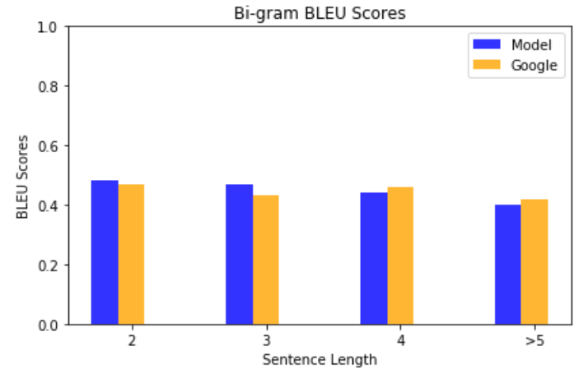
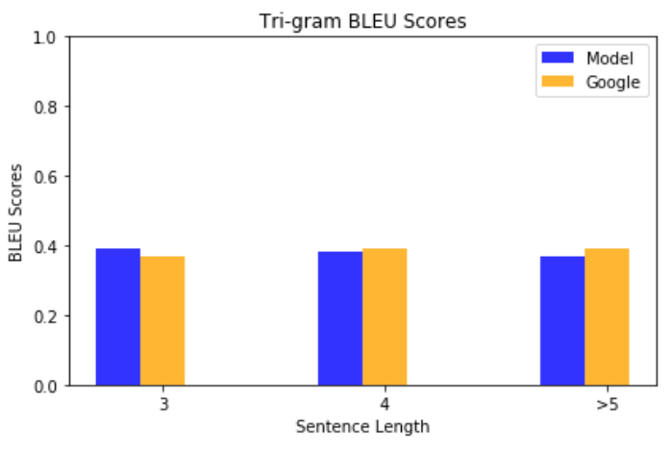
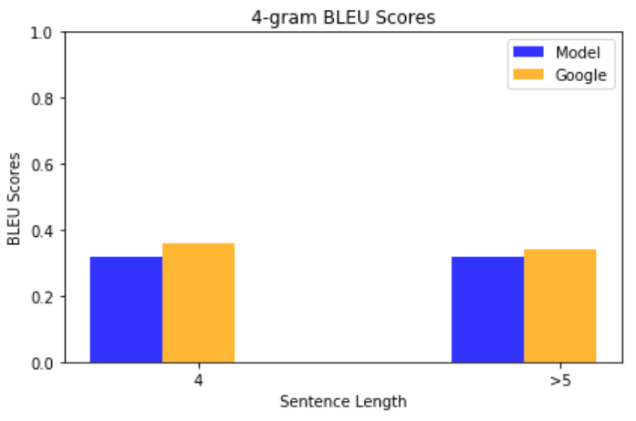
BLEU Score Comparison

Slide 16
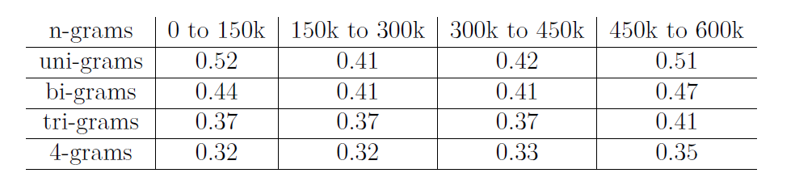
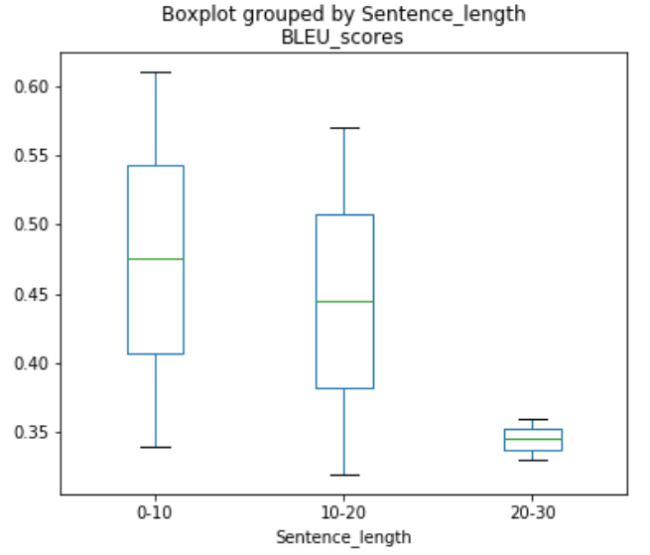
Error Analysis and Limitations
BLEU scores decrease as the sentence length increases.
The Model does not perform very well on long sentences.
Frequency of word occurrences contribute a great deal towards the
translation accuracies.
Beam width could be increased to get more possible translations
<OOV> words will not be translated.

Slide 17
To sum up…
Challenges faced: pre-processing of data, limited vocabulary, computational limitations
Future enhancements: Web application development for interactive translations, improved BLEU scores (there’s always a scope!)
Tools used: Python programming language, Linux OS, GPU that supports the CUDA® Deep Neural Network library (cuDNN) designed for Nvidia GPUs.
Learning outcome: understanding of efficient training methodologies for Deep Neural Networks and building a model which is good enough to be trained on any language pairs (special linguistic features to be considered)

Slide 18

Questions?

